Slide 1
Why are clean water and air important?
Daniela Draaisma Rodriguez

Slide 2
Introduction
Human beings compete with other animals and organisms of the planet for resources and space. The world population is an continous increasing factor and the standards of living, for human beings, are improving. This means we can afford to have cars, build houses, eat as much food as we desire, etc. However human activities have lead to polution of the planet, that can later become a permanent damage, especially in air and water.

Slide 3
Impacts of humans
The world of human population has increased massively and it continues to increase. As metioned before, people enjoy high standards of living to satisfy their wants and their needs. However this has caused some strains on the global enviroment. Example:
Raw materials are being used up rapidly
More waste is being produced
Non-renewable resources are being used up rapidly (coal, natural gas and oil)
More pollution is being produced

Slide 4
Facts about water
More than two thirds of the human body is made out of water.
Water is a fundemental human need, each person requires the use of 20-50 liters of clean water a day for drinking, cooking, cleaning, etc.
Drinking water serves as a lubricant in digestion and it also helps regulate the body temperature.
Water also supplies oxygen and nutrients to the cells.
About 70% of the earth is made out of water, but only 1% of that water is pure drinking water.

Slide 5
The importance of water:
In other words water is important because it is the fundemental need for living, not only for humans but also for other living creatures. However water affects other factors such as education, health, women, men, children and poverty. If we were to imagine that there is no more clean water in the planet people would die of dehydration, farmers would not be able to grow crops, livestock and animals would become extinct, thus that would lead to food shortages and poverty levels would increase. Then education levels will drop and children would dstop recieving an education. Also deseases and viruses become widespread due to unpure water being collected. In conclusion water is very important for our existance.

Slide 6
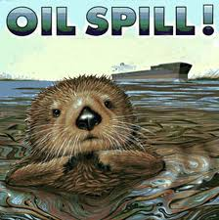
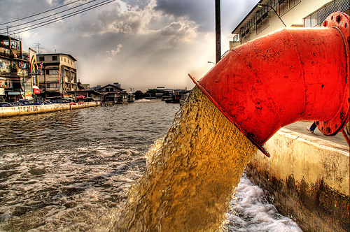
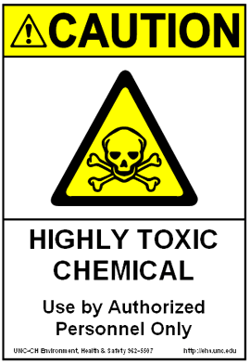
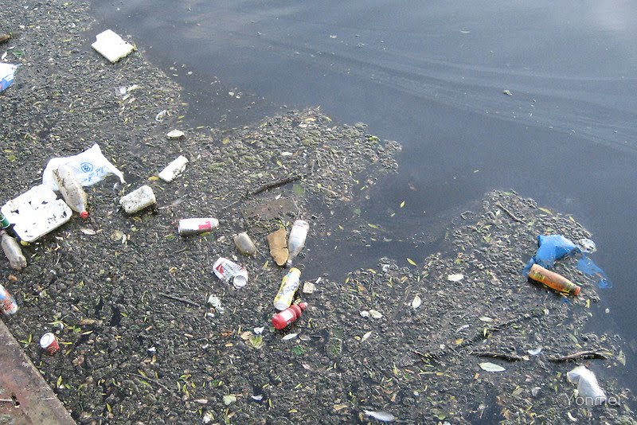
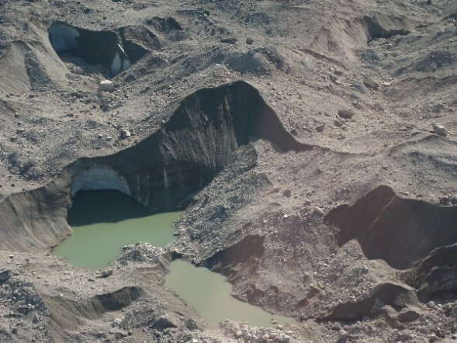
How is water being polluted?
Sewage
A body of water is said to be polluted when toxic substances damage it
Silt
Domestic waste

Slide 7
Why is air important?
Air is important for many different organisms for different reasons. One of the main reasons it is important for humans is that it contains oxygen - which we breathe. Furthermore, it enables the removal of our waste CO2 - which is taken up plants.

Slide 8
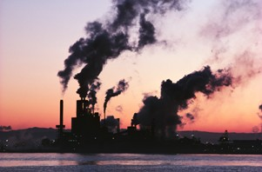
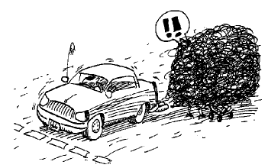
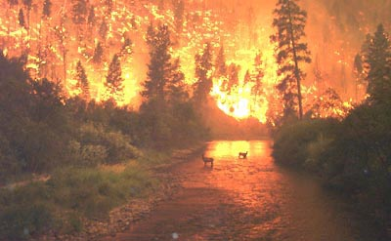
How do we pollute air?
Industry air pollution
Car fumes
Wildfires

Slide 9
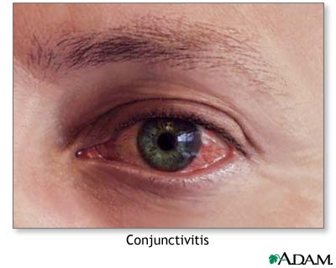
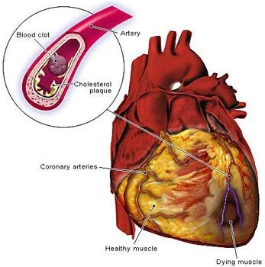
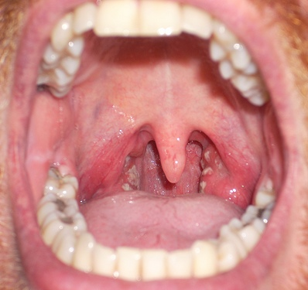
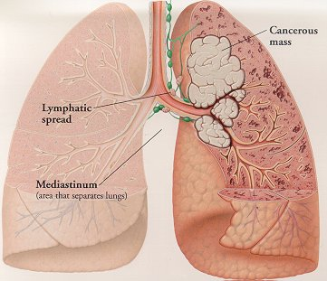
What health problems can these cause us?
Eye irritation
Heart disease
Lung cancer
Throat irritation
Nose irritation

Slide 10
What can we do?
http://www.youtube.com/watch?v=h8Ek3v1RBEU
http://www.youtube.com/watch?v=zIforUNXrUQ
http://www.youtube.com/watch?v=VzsQwwnqSGo&feature=relmfu
http://www.youtube.com/watch?v=VvFsMe8_NIM&feature=relmfu
http://www.youtube.com/watch?v=jCQdXXkJD_8&feature=relmfu
And much more

